Slide 1
Millimeter Wave Communication
UNIT 5
18ECE220T AMCS

Slide 2
Topics
Millimeter wave Characteristics
Introduction to channel performance at mmWave communication
Channel performance at mmWave communication
Modulation for mmWave Communication
Millimeter wave transmitter
Millimeter wave receiver
Millimeter wave antenna
Introduction to mmWave communications
Emerging applications of mmWave communications
Millimeter wave standards
Introduction to Millimeter-wave standards
Development of Millimeter wave standards

Slide 3
Millimeter wave Characteristics

Slide 4
Millimeter wave Characteristics
Corresponding to the progress of multimedia technology and data storage technology, a high data rate of 10 Gbit/s is expected, driven by the increasing memory capacity in wireless/mobile devices
It seems clear that the demand for a high data rate and high-integrity services will continue to grow in the foreseeable future, especially at the V band (40–75 GHz) and W band (75–111 GHz)
In very broad terms, millimeter wave technology can be classified as occupying the electromagnetic spectrum that spans between 30 and 300 GHz, which corresponds to wavelengths from 10 to 1 mm

Slide 5
Millimeter wave Characteristics
Millimeter waves are usually considered to be the range of wavelengths from 10 to 1 mm.
This means they are larger than infrared waves or x-rays, for example, but smaller than radio waves or microwaves.
The millimeter-wave region of the electromagnetic spectrum corresponds to the radio band frequency range of 30–300 GHz and is also called the extremely high frequency (EHF) range.
The high frequencies of millimeter waves, as well as their propagation characteristics (i.e., the ways they change or interact with the atmosphere as they travel), make them useful for a variety of applications, including the transmission of large amounts of data, cellular communications, and radar

Slide 6
Key Benefits
Unlicensed operation—No license from the Federal Communications Commission is required.
Highly secure operation—Resulting from short transmission distances due to oxygen absorption, narrow antenna beamwidth, and no wall penetration.
High level of frequency re-use enabled—The communication needs of multiple cells within a small geographic region can be satisfied
Fiber optic data transmission speeds possible—7 GHz (in the U.S.) of continuous bandwidth available compared to less than 0.3 GHz at the other unlicensed bands
Mature technology—This spectrum has a long history of being used for secure communications
Carrier-class communication links enabled—60 GHz links can be engineered to deliver “five nines” (99.999%) availability if desired. For outdoor applications, such as back bones or by-pass bridges, a huge rain margin should be considered.

Slide 7
Characterizations of millimeter wave
Two aspects of the characterizations of millimeter waves can be discussed:
Free space propagation
Loss factors

Slide 8

Free Space Propagation
As with all propagating electromagnetic waves, for millimeter waves in free space the power falls off as the square of the range.
When the range is doubled, the power reaching a receiver antenna is reduced by a factor of four.
This effect is due to the spherical spreading of the radio waves as they propagate.
The frequency and distance dependence of the loss between two isotropic antennas can be expressed in absolute numbers by the following equation (in dB):

Slide 9
Free Space Propagation
where L_{free} space is the free-space loss, R is the distance between the transmitting and receiving antennas, and λ is the operating wavelength.
This equation describes line-of-sight (LOS) wave propagation in free space. It shows that the free space loss increases when the frequency or range increases
Also, that millimeter wave free space loss can be quite high even for short distances. It suggests that the millimeter-wave spectrum is best used for short-distance communication links

Slide 10

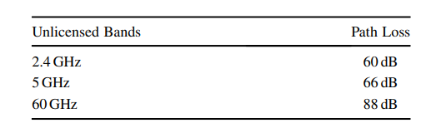
Free Space Propagation
When the distance of the link R =10 m, path loss can be calculated using.
The path losses of different unlicensed bands are listed below.

Slide 11

Free Space Propagation
Another way of expressing the path loss is the Friis Equation
where GTX transmitting antenna gain, GRX receiving antenna gain, R is the line-of-sight distance separating the transmitting and receiving antennas, and L system loss factor

Slide 12
Millimeter-Wave Propagation Loss Factors
In addition to the free-space loss, which is the main source of transmission loss, there are also absorption loss factors, such as gaseous losses and losses from rain (or other micrometers) in the transmission medium.
Atmospheric losses mean that transmission losses occur when millimeter waves traveling through the atmosphere are absorbed by molecules of oxygen, water vapor, and other gaseous atmospheric constituents.
These losses are greater at certain frequencies, coinciding with the mechanical resonant frequencies of the gas molecules.

Slide 13
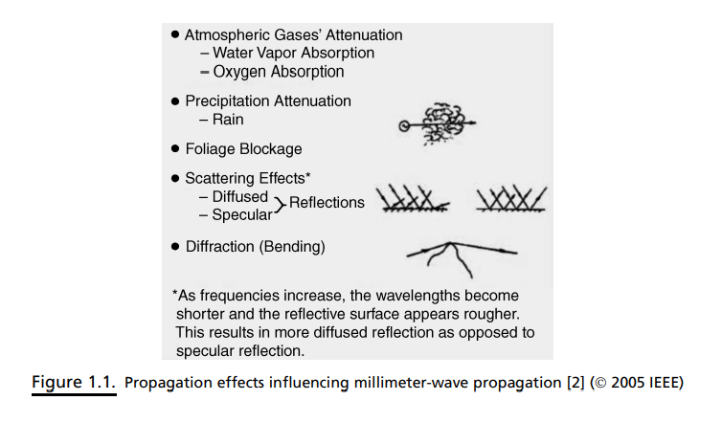
Millimeter-Wave Propagation Loss Factors

Slide 14
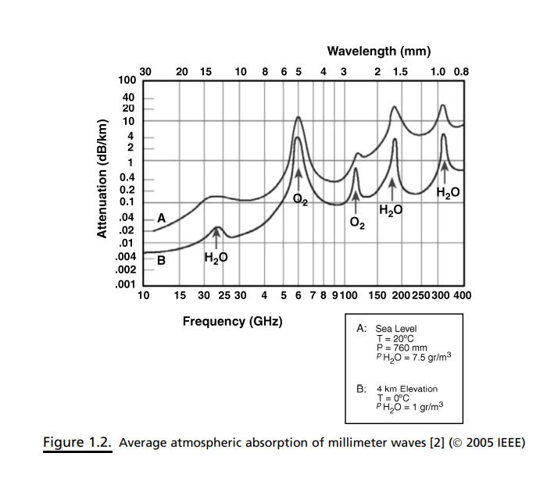
Millimeter-Wave Propagation Loss Factors
TheH₂OandO₂ resonances have been studied extensively for the purpose of predicting millimeter wave propagation characteristics. Figure 1.2 shows an expanded plot of the atmospheric absorption versus frequency at an altitude of 4 km and at sea level, for water content of 1 gm/m³ and 7.5 gm/m³ , respectively

